Slide 1
NLP MIMIC III
Maziyar Mirzaei
Ai in healthcare
Fall 2024 ut austin

Slide 2
Analyzing Diabetes Patient Notes with NLP Techniques
Objective: To process clinical notes of diabetes patients from the MIMIC-III dataset using NLP methods such as SpaCy, SciSpaCy, Word2Vec, and BERT models for entity recognition and embedding visualization.

Slide 3
Data Loading
Loading Clinical Notes and Diagnoses Data
Explanation: Load the first 50,000 rows of the NOTEEVENTS.csv file and the entire DIAGNOSES_ICD.csv file into pandas DataFrames for processing.
import pandas as pd # Load the data data = pd.read_csv('NOTEEVENTS.csv', nrows=50000) # Load diagnoses data diagnoses = pd.read_csv('DIAGNOSES_ICD.csv')

Slide 4
Filtering for Diabetes Diagnoses
Title: Identifying Diabetes Patients
Explanation: Filter the diagnoses to include only those with ICD-9 codes corresponding to Diabetes Mellitus.
# Load diagnoses data diagnoses = pd.read_csv('DIAGNOSES_ICD.csv') # Filter for Diabetes Mellitus ICD-9 codes diabetes_codes = [f'250{str(i).zfill(2)}' for i in range(0, 100)] diabetes_diagnoses = diagnoses[diagnoses['ICD9_CODE'].isin(diabetes_codes)].copy() # Create a unique identifier for SUBJECT_ID and HADM_ID diabetes_diagnoses.loc[:, 'SUBJ_HADM_ID'] = diabetes_diagnoses['SUBJECT_ID'].astype(str) + '_' + diabetes_diagnoses['HADM_ID'].astype(str) # Similarly, prepare the notes data data['SUBJ_HADM_ID'] = data['SUBJECT_ID'].astype(str) + '_' + data['HADM_ID'].astype(str) # Merge the notes with the Diabetes diagnoses diabetes_notes = data[data['SUBJ_HADM_ID'].isin(diabetes_diagnoses['SUBJ_HADM_ID'])].copy() # Reset index diabetes_notes = diabetes_notes.reset_index(drop=True)

Slide 5
Merging Notes with Diagnoses
Title: Merging Clinical Notes with Diabetes Diagnoses
Explanation: Create a unique identifier by combining SUBJECT_ID and HADM_ID, then merge the notes with the diabetes diagnoses based on this identifier.
# Create a unique identifier for SUBJECT_ID and HADM_ID diabetes_diagnoses['SUBJ_HADM_ID'] = diabetes_diagnoses['SUBJECT_ID'].astype(str) + '_' + diabetes_diagnoses['HADM_ID'].astype(str) # Similarly, prepare the notes data data['SUBJ_HADM_ID'] = data['SUBJECT_ID'].astype(str) + '_' + data['HADM_ID'].astype(str) # Merge the notes with the Diabetes diagnoses diabetes_notes = data[data['SUBJ_HADM_ID'].isin(diabetes_diagnoses['SUBJ_HADM_ID'])] # Reset index diabetes_notes = diabetes_notes.reset_index(drop=True)

Slide 6
Data Cleaning
Title: Cleaning Clinical Notes Text
Explanation: Remove null entries in the TEXT column and clean the text by removing de-identification brackets and extra whitespace.
import re # Remove null TEXT entries diabetes_notes = diabetes_notes.dropna(subset=['TEXT']) # Function to clean text def clean_text(text): text = re.sub(r'\[\*\*.*?\*\*\]', '', text) # Remove de-identification brackets text = re.sub(r'\s+', ' ', text) # Remove extra whitespace return text.strip() diabetes_notes['CLEAN_TEXT'] = diabetes_notes['TEXT'].apply(clean_text)

Slide 7
Loading NLP Models
Title: Loading SpaCy and SciSpaCy Models
Explanation: Load the necessary SpaCy and SciSpaCy models for NLP processing, including the biomedical NER model.
import spacy # Load SpaCy's English model nlp_spacy = spacy.load('en_core_web_sm') # Load SciSpaCy's models nlp_scispacy = spacy.load('en_core_sci_sm') # Load SciSpaCy's NER model for biomedical data nlp_scispacy_ner = spacy.load('en_ner_bc5cdr_md')

Slide 8
Entity Recognition with SpaCy
Output:
List of entities identified by SpaCy with their labels (e.g., Zocor / Lescol Attending - ORG).
Title: Extracting Entities with SpaCy
Explanation: Use SpaCy's English model to extract entities from a sample clinical note.
SpaCy Entities: Zocor / Lescol Attending - ORG History of Present Illness - WORK_OF_ART 84 - CARDINAL 1 - CARDINAL 28 - CARDINAL 25-30% - PERCENT CAD - ORG s/p CABG - ORG SVG - ORG LIMA - GPE SVG-OM - ORG ...
doc_spacy = nlp_spacy(diabetes_notes['CLEAN_TEXT'][0]) print("SpaCy Entities:") for ent in doc_spacy.ents: print(f"{ent.text} - {ent.label_}")

Slide 9
Entity Recognition with SciSpaCy
Title: Extracting Entities with SciSpaCy
Explanation: Use SciSpaCy's model to extract scientific and biomedical entities from the same clinical note.
Output:
List of entities identified by SciSpaCy with the label ENTITY.
SciSpaCy Entities: Admission - ENTITY Discharge Date - ENTITY Service - ENTITY MEDICINE Allergies - ENTITY Zocor - ENTITY Lescol - ENTITY Attending - ENTITY Chief Complaint - ENTITY Chest pain - ENTITY Surgical - ENTITY Invasive Procedure - ENTITY Central venous line insertion - ENTITY right internal jugular vein) History of Present - ENTITY Illness - ENTITY Mr. - ENTITY man – ENTITY ...
doc_scispacy = nlp_scispacy(diabetes_notes['CLEAN_TEXT'][0]) print("\nSciSpaCy Entities:") for ent in doc_scispacy.ents: print(f"{ent.text} - {ent.label_}")

Slide 10
Biomedical NER with SciSpaCy
Title: Extracting Biomedical Entities with SciSpaCy NER
Explanation: Use SciSpaCy's biomedical NER model to extract chemical and disease entities.
Output:
List of entities with labels CHEMICAL and DISEASE (e.g., Zocor - CHEMICAL, chest pain - DISEASE).
doc_scispacy_ner = nlp_scispacy_ner(diabetes_notes['CLEAN_TEXT'][0]) print("\nSciSpaCy NER Entities:") for ent in doc_scispacy_ner.ents: print(f"{ent.text} - {ent.label_}")
SciSpaCy NER Entities: Allergies - DISEASE Zocor - CHEMICAL Lescol - CHEMICAL Chest pain - DISEASE stenosis - DISEASE mitral regurgitation - DISEASE aortic insufficiency - DISEASE chronic left ventricular systolic heart failure - DISEASE hypertension - DISEASE hyperlipidemia - DISEASE diabetes mellitus - DISEASE CAD - DISEASE SVG-OM - CHEMICAL SVG-OM - CHEMICAL peripheral arterial disease - DISEASE ...

Slide 11
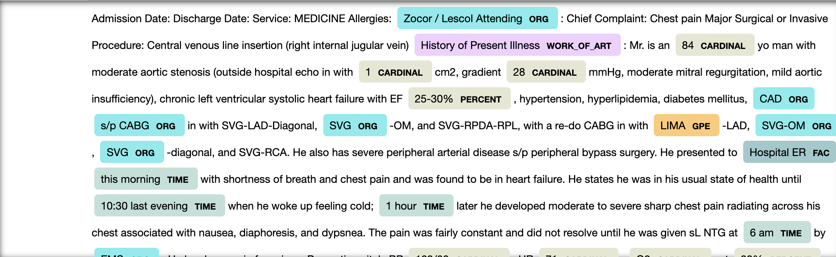
Visualizing Entities
Title: Visualizing Entities with displaCy
Explanation: Use SpaCy's displaCy visualizer to display entities in the text.
from spacy import displacy # SpaCy Visualization displacy.render(doc_spacy, style="ent", jupyter=True) # SciSpaCy Visualization displacy.render(doc_scispacy_ner, style="ent", jupyter=True)
Visualization:
Annotated text highlighting entities such as medications, diseases, and procedures.

Slide 12
Preprocessing Text for Word2Vec
Title: Preprocessing Text Data
Explanation: Tokenize and preprocess the cleaned text for Word2Vec modeling, removing stopwords and short tokens.
from gensim.utils import simple_preprocess from gensim.parsing.preprocessing import STOPWORDS def preprocess(text): return [token for token in simple_preprocess(text) if token not in STOPWORDS and len(token) > 3] documents = diabetes_notes['CLEAN_TEXT'].map(preprocess)

Slide 13
Training Word2Vec Model
Title: Training a Word2Vec Model on Clinical Notes
Explanation: Train a Word2Vec model using the preprocessed documents to learn word embeddings.
Output:
Words similar to 'insulin’: [ ('humalog', 0.7126625180244446), ('lantus', 0.6957399845123291), ('insuling', 0.6520899534225464), ('hiss', 0.6348435878753662), ('insuln', 0.6166067719459534), ('riss', 0.595574140548706), ('fingersticks', 0.5858661532402039), ('glargin', 0.5817741751670837), ('units', 0.555779755115509), ('ultralente', 0.5463814735412598) ]
from gensim.models import Word2Vec model = Word2Vec(sentences=documents, vector_size=100, window=5, min_count=2, workers=4) # Most similar words to 'insulin' print("Words similar to 'insulin':") print(model.wv.most_similar('insulin'))

Slide 14
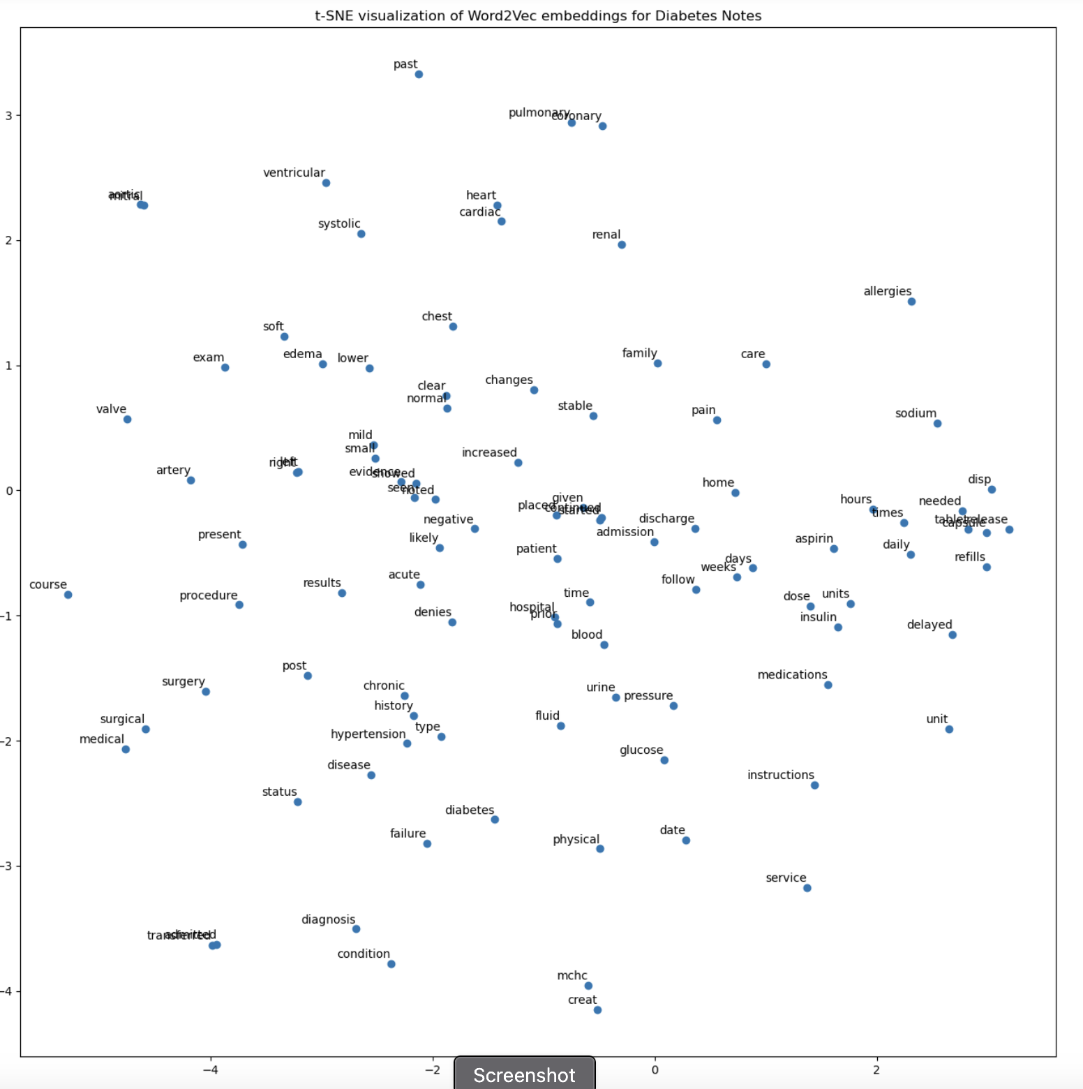
Visualizing Word Embeddings with t-SNE
Title: Visualizing Word2Vec Embeddings
Explanation: Use t-SNE to reduce the dimensionality of word embeddings and visualize them.
from sklearn.manifold import TSNE import matplotlib.pyplot as plt import numpy as np # Get vocabulary and limit to top N words vocab = list(model.wv.key_to_index)[:100] # Get word vectors X = model.wv[vocab] tsne = TSNE(n_components=2, perplexity=30, random_state=42) X_tsne = tsne.fit_transform(X) plt.figure(figsize=(16, 16)) plt.scatter(X_tsne[:, 0], X_tsne[:, 1]) for i, word in enumerate(vocab): plt.annotate(word, xy=(X_tsne[i, 0], X_tsne[i, 1]), textcoords='offset points', xytext=(0, 5), ha='right') plt.title('t-SNE Visualization of Word2Vec Embeddings for Diabetes Notes') plt.show()

Slide 15
Using ClinicalBERT for Embeddings
Title: Generating Embeddings with ClinicalBERT
Explanation: Use the emilyalsentzer/Bio_ClinicalBERT model to generate embeddings for a clinical note.
from transformers import AutoTokenizer, AutoModel import torch tokenizer = AutoTokenizer.from_pretrained("emilyalsentzer/Bio_ClinicalBERT") model_bert = AutoModel.from_pretrained("emilyalsentzer/Bio_ClinicalBERT") # Tokenize and encode a sample note inputs = tokenizer(diabetes_notes['CLEAN_TEXT'][0], return_tensors="pt", max_length=512, truncation=True) # Get the embeddings with torch.no_grad(): outputs = model_bert(**inputs) embeddings = outputs.last_hidden_state # Shape: [batch_size, sequence_length, hidden_size]

Slide 16
Visualizing ClinicalBERT Embeddings
Title: Visualizing Token Embeddings with t-SNE
Explanation: Reduce the dimensions of the token embeddings and visualize them using t-SNE.
# Convert embeddings to numpy for visualization token_embeddings = embeddings[0].numpy() # Get tokens tokens = tokenizer.tokenize(diabetes_notes['CLEAN_TEXT'][0], max_length=512, truncation=True) # Reduce dimensions tsne = TSNE(n_components=2, perplexity=30, random_state=42) embeddings_tsne = tsne.fit_transform(token_embeddings) # Plot plt.figure(figsize=(16, 16)) plt.scatter(embeddings_tsne[:, 0], embeddings_tsne[:, 1]) for i, token in enumerate(tokens): plt.annotate(token, xy=(embeddings_tsne[i, 0], embeddings_tsne[i, 1]), textcoords='offset points', xytext=(0, 5), ha='right') plt.title('t-SNE Visualization of ClinicalBERT Embeddings for Diabetes Notes') plt.show()

Slide 17
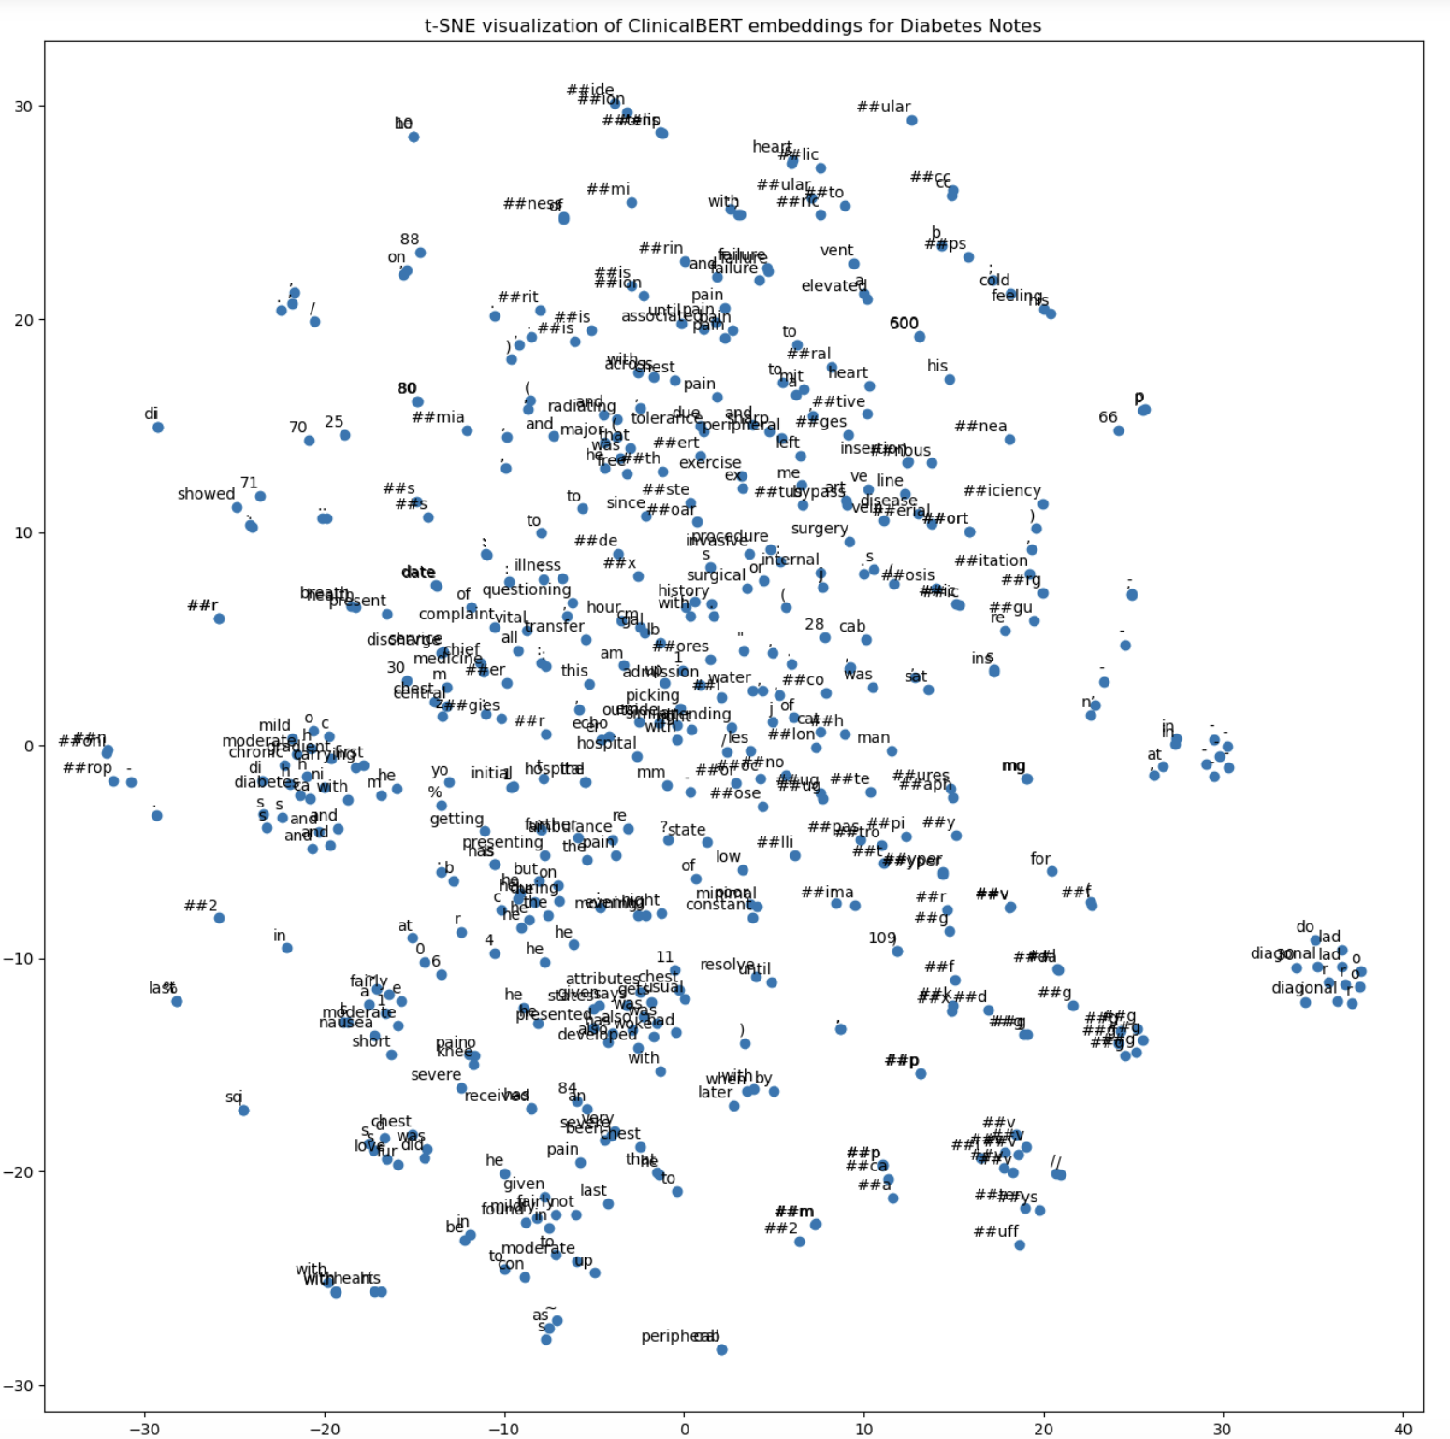

Slide 18
Comparing ClinicalBERT with Standard BERT
Title: Tokenization Comparison between ClinicalBERT and BERT
Explanation: Compare the tokens generated by ClinicalBERT and standard BERT models to highlight differences in handling clinical text.
# Load standard BERT tokenizer from transformers import BertTokenizer, BertModel bert_tokenizer = BertTokenizer.from_pretrained('bert-base-uncased') bert_model = BertModel.from_pretrained('bert-base-uncased') # Tokenize with standard BERT bert_tokens = bert_tokenizer.tokenize(diabetes_notes['CLEAN_TEXT'][0], max_length=512, truncation=True) # Compare tokens print("Standard BERT Tokens:") print(bert_tokens) print("\nClinicalBERT Tokens:") print(tokens)

Slide 19
Output:
Lists of tokens from both models showing that ClinicalBERT better handles medical terminology.
Standard BERT Tokens: ['admission', 'date', ':', 'discharge', 'date', ':', 'service', ':', 'medicine', 'all', '##er', '##gies', ':', 'z', '##oco', '##r', '/', 'les', '##col', 'attending', ':', 'chief', 'complaint', ':', 'chest', 'pain', 'major', 'surgical', 'or', 'invasive', 'procedure', ':', 'central', 've', '##nous', 'line', 'insertion', '(', 'right', 'internal', 'jug', '##ular', 'vein', ')', 'history', 'of', 'present', 'illness', ':', 'mr', '.', 'is', 'an', '84', 'yo', 'man', 'with', 'moderate', 'ao', '##rti', '##c', 'ste', '##nosis', '(', 'outside', 'hospital', 'echo', 'in', 'with', '1', 'cm', '##2', ',', 'gradient', '28', 'mm', '##hg', ',', 'moderate', 'mit', '##ral', 'reg', '##urg', '##itation', ',', 'mild', 'ao', '##rti', '##c', 'ins', '##uf', '##fi', '##ciency', ')', ',', 'chronic', 'left', 'vent', '##ric', '##ular', 'sy', '##sto', '##lic', 'heart', 'failure', 'with', 'e', '##f', '25', '-', '30', '%', ',', 'hyper', '##tension', ',', 'hyper', '##lip', '##ide', '##mia', ',', 'diabetes', 'mel', '##lit', '##us', ',', 'cad', 's', '/', 'p', 'cab', '##g', 'in', 'with', 'sv', '##g', '-', 'lad', '-', 'diagonal', ',', 'sv', '##g', '-', 'om', ',', 'and', 'sv', '##g', '-', 'r', '##pd', '##a', '-', 'r', '##pl', ',', 'with', 'a', 're', '-', 'do', 'cab', '##g', 'in', 'with', 'lima', '-', 'lad', ',', 'sv', '##g', '-', 'om', ',', 'sv', '##g', '-', 'diagonal', ',', 'and', 'sv', '##g', '-', 'rca', '.', 'he', 'also', 'has', 'severe', 'peripheral', 'arterial', 'disease', 's', '/', 'p', 'peripheral', 'bypass', 'surgery', '.', 'he', 'presented', 'to', 'hospital', 'er', 'this', 'morning', 'with', 'short’,...

Slide 20
Top 10 Entitles from all diabetes notes
# Extract entities from all diabetes notes entities = [] for text in diabetes_notes['CLEAN_TEXT']: doc = nlp_scispacy_ner(text) entities.extend([ent.text for ent in doc.ents]) # Count entity frequencies from collections import Counter entity_counts = Counter(entities) most_common_entities = entity_counts.most_common(10) # Separate labels and counts labels, counts = zip(*most_common_entities) # Plot plt.figure(figsize=(10, 6)) plt.barh(labels, counts, color='teal') plt.gca().invert_yaxis() plt.xlabel('Frequency') plt.title('Top 10 Entities in Diabetes Notes') plt.show()

Slide 21
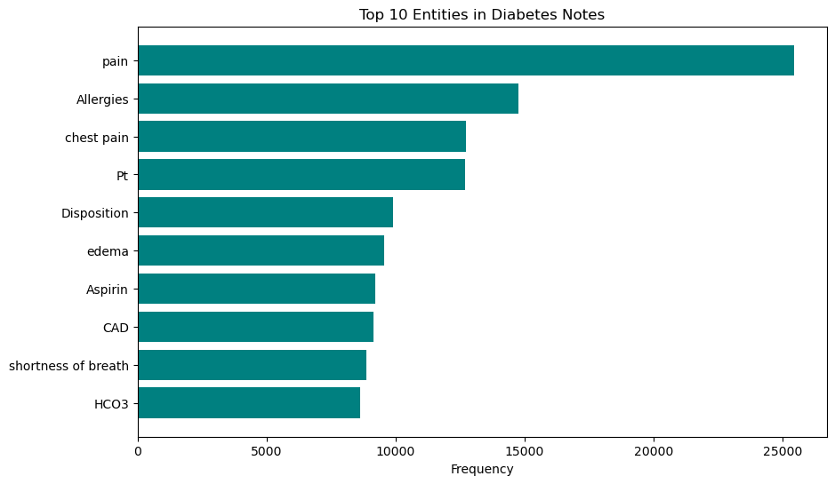

Slide 22
Observations and Insights
Title: Key Takeaways from NLP Analysis
Explanation:
Entity Recognition:
SpaCy provides general-purpose entity recognition.
SciSpaCy and its NER model effectively identify biomedical entities like diseases and chemicals.
Word Embeddings:
Word2Vec captures semantic relationships between medical terms (e.g., 'insulin' is similar to 'lantus' and 'humalog').
ClinicalBERT generates contextual embeddings tailored for clinical text.
Tokenization Differences:
ClinicalBERT tokenizes medical terms more appropriately than standard BERT, leading to better representations.

